Slide 1
Artificial Intelligence (AI) vs Machine Learning (ML)
vs
Deep Learning (DL)
Created By
Nusrat Jahan Anka
All Rights reserved by Nusrat Jahan Anka (Nusrat Anka)

Slide 2
Introduction
Evaluation
Main Differences
Working Process
Fundamentals
Better To Start
Skills
Career Scopes
References

Slide 3
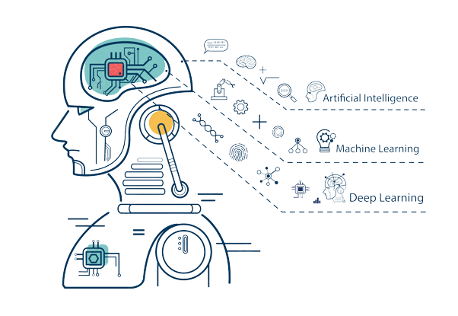
Introduction
Train a behaviour
Train a system
Train a model

Slide 4
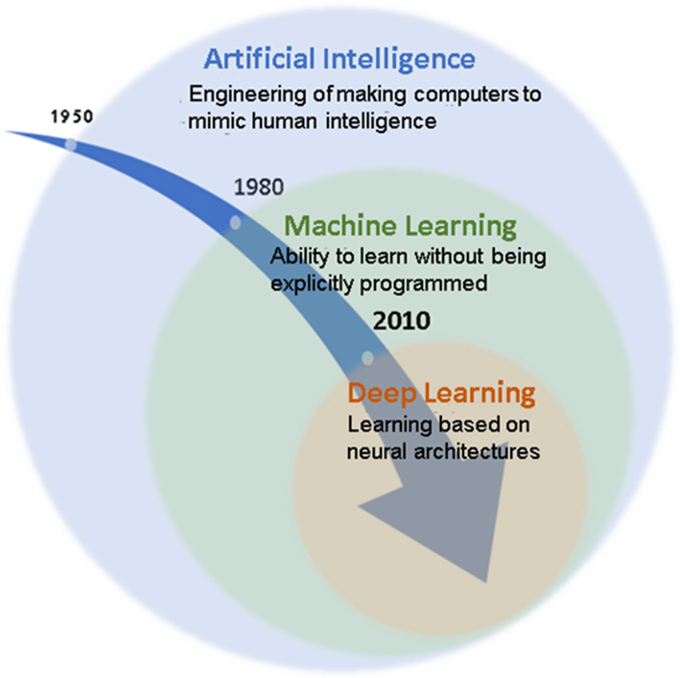
Evolution

Slide 5
Main Differences
AI ML DL
AI represents simulated ML is the practice of It’s a artificial neural
Intelligence in machines. Getting machines to networks to solve
Make decisions without complex problems.
Being programmed.
AI is subset of ML is a subset of DL is a subset of AI,
Data Science. AI & Data Science. ML & Data Science
Aim towards building Aims to learn through Aims to build neural
machines that are data to solve the program. networks that
capable to think like automatically discover
Humans. patterns for feature
detection.

Slide 6
Working Process
AI
Collect Data
Clean & Prepare Data
Train The Model
Test The Data
Improve
ML
Gather Data
Label Data
Choose Algorithm
Deploy Final Model
DL
Gather Data
Process & Filter Data
Train The Model
Choose Algorithm
Test The Performance

Slide 7
Fundamentals
Fundamentals
Data structures
Algorithms
Computability and complexity, and
Computer architecture
DL
AI
ML

Slide 8

Better to start

Slide 9
Skills
ML
AI
DL
Identify patterns in data
Build models to make predictions
Optimize performance
Evaluate models for accuracy
Work with large data set
Data analysis
Pattern recognition
Machine learning
Predictive modeling
Computer vision
Expert systems
Neural networks
Programming
Data Wrangling
Data Visualization
Data Analysis
Machine Learning

Slide 10
Career Scopes
Data Scientist
Machine Learning Engineer
Research Scientist
Business Intelligence Developer
AI Data Analyst
Big data engineering
Robotics Scientist
AI engineer
Data Analyst
Data Engineer

Slide 11
References
AI, ML and DL: What's the Difference? - Open Source For You
AI vs ML vs DL vs DS - Know The Differences - Naukri.com
Machine Learning versus Deep Learning - Studytonight
AI vs. Machine Learning vs. Deep Learning - Springboard
Which is better to start; AI, ML, or DL? - Quora
Data Science vs Machine Learning and Artificial Intelligence
8 Best Career Scopes in AI and ML engineering - CIT
Careers in Deep Learnings - eduCBA

